Slide 1

Introduction to Scapy
M. Eng
Chunyang Jia
Xiaoxuan Yu
Tingjun Wan
Notes:
Hi everyone, today we'd like to discuss scapy

Slide 2
Content
Background
Basic usage
Advanced usage
Demo
Conclusion
Notes:
We will be covering these 5 key points

Slide 3
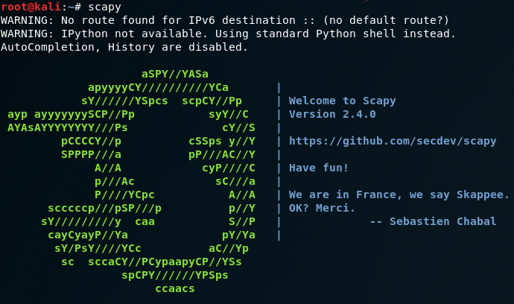
What is SCAPY?
A Python framework used for crafting and transmitting packets.
Capable of Sniffing or replaying packets for troubleshooting or fuzzing network services.
Can be used as the interactive Python interpreter or the framework can be imported as a python module and used for further coding
Notes:
So what is scapy, there are some concepts about scapy, which is a powerful packet manipulation resource.
In other words, It is able to forge or decode packets of several protocols, send and capture them. Scapy also can easily handle most network tasks, like for example scanning, tracerouting, and different attacks .

Slide 4

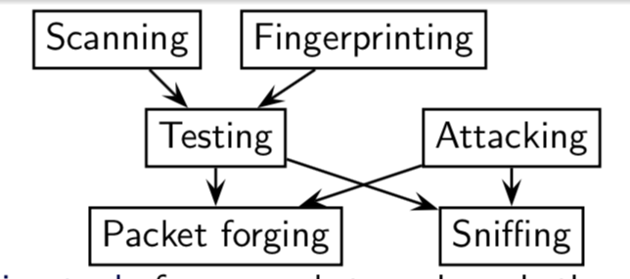
Why SCAPY?
Other tool problems:
won’t build something the author did not imagine
usually confuse decoding and interpreting
combining technics is not possible
partially decode what they receive
Sniffing tools: dsniff, net2pcap. Forging tools: packeth, Testing tools: ping, hping2
Scanning tools: nmap. Fingerprinting tools: xprobe. Attacking tools: hunt
Notes:
1.It is basic classification of packet building tools. And we already have some tools which can achieve goals. But why we need scapy?
Cuz most tools may have those problems.
2. Firstly, you won’t build something the author did not imagine. These tools have been built for a specific goal and can’t deviate much from it
3.and they do not give you all the information they received. The network’s vision they give you is their author thought was sufficient. But it is not complete, and you may have a bias.
5.Scapy tries to overcome those problems. It enables you to build exactly the packets you want. Scapy has a flexible model that tries to avoid such arbitrary limits. You’re free to put any value you want in any field you want and stack them like you want.
In fact, it’s like building a new tool each time, you only write 2 lines of Scapy,but instead of dealing with a hundred line C program.

Slide 5
For Who
For who :
Gaining an in depth knowledge of the TCP/IP stack
Great tool for security/network analysts and testers
Attackers
Some supported protocols:
ARP, DHCP, DNS, 802.11, WEP, 802.3, Ethernet, 802.1q, L2CAP, LLC, SNAP, EAP, HSRP, IP, UDP, TCP, . . .
Some applications:
ARP cache poisoning, VLAN hopping, DNS spoofing, OS fingerprinting, DoSing, Dynamic DNS updates, traceroutes, scanning... .
Notes:
1. Scapy is really useful for someone who wanna have a better understanding of TCP/IP stack, or some security analysts and testers.
As mentioned before, it support many protocols and have different applicatios.
Then, my friends will talk about basic usage.

Slide 6
Basic usage
Forge network packets
Send network packets
Sniff network packets
Dissect network packets

Slide 7
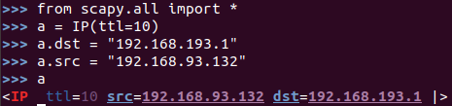
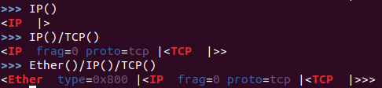
FORGE PACKETs
Start a packet
Stacking Layers

Slide 8
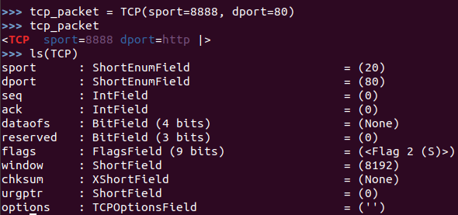
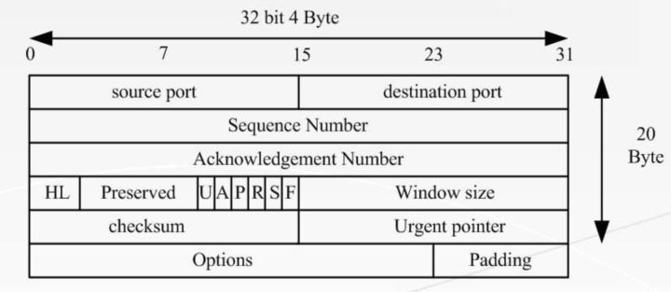
FORGE PACKETs
For example: A TCP packet

Slide 9
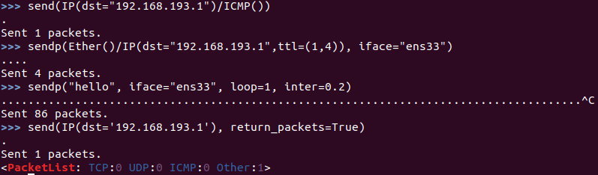
Send packets
Notes:
Now, let’s try to do some fun things. The sr() function is for sending packets and receiving answers. The function returns a couple of packet and answers, and the unanswered packets. The function sr1() is a variant that only returns one packet that answered the packet (or the packet set) sent. The packets must be layer 3 packets (IP, ARP, etc.). The function srp() do the same for layer 2 packets (Ethernet, 802.3, etc.). If there is, no response a None value will be assigned instead when the timeout is reached.

Slide 10
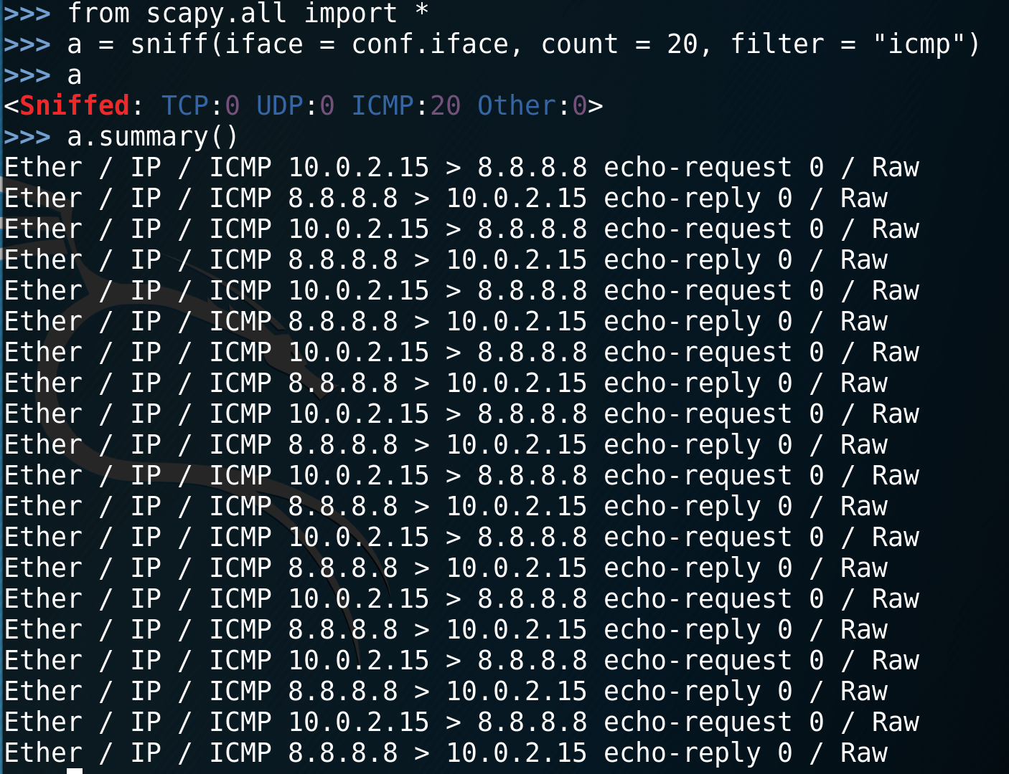
Sniffing packets
Notes:
Now people talk about hacker attacks, generally referring to the active way, such as exploiting vulnerabilities or guessing system passwords to attack the system. But in fact, there is another kind of passive attack which is very harmful and often neglected by everyone. That is sniffer attack.
Using this tool, you can monitor the status of the network, data flow and information transmitted on the network.
Information as username and password is located in a Raw layer of the package in load field.
We can easily capture some packets or even clone tcpdump or tshark. Either one interface or a list of interfaces to sniff on can be provided.
iface ：network interface which scapy going to monitor
(usually not all network interfaces)。
PRN ：specifies a callback function, and whenever a filter-compliant message is detected, the callback function is executed, usually using lambda expressions to write the callback function.
It can Print out the summary of the captured message:
And also Print out the source address of all IP messages:
count :specifies how many messages to sniff at most (referring to messages that meet filter criteria, not all messages)
filter： uses Berkeley Packet Filter (BPF) ，That's the filtering grammar we use in wireshark
According to the conditions set by filter, the qualified data packets are received back.
Eg. filter="tcp and host 192.168.1.1 and port 80"

Slide 11
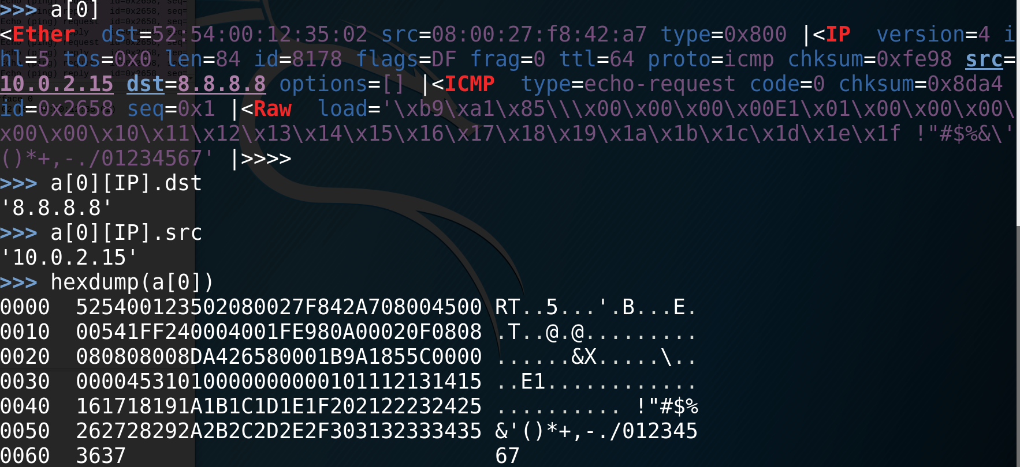
Dissect Packets
Notes:
Scpy displays detailed package information according to the four-layer reference model of TCP/IP, namely, link layer [Ethernet], network layer [IP], transport layer [TCP/UDP], application layer [RAW]. We can also view specified packages through protocols:
As long as Wireshark can be resolved, so can scapy

Slide 12
Advanced usage
Traceroute
SYN flood attacks

Slide 13
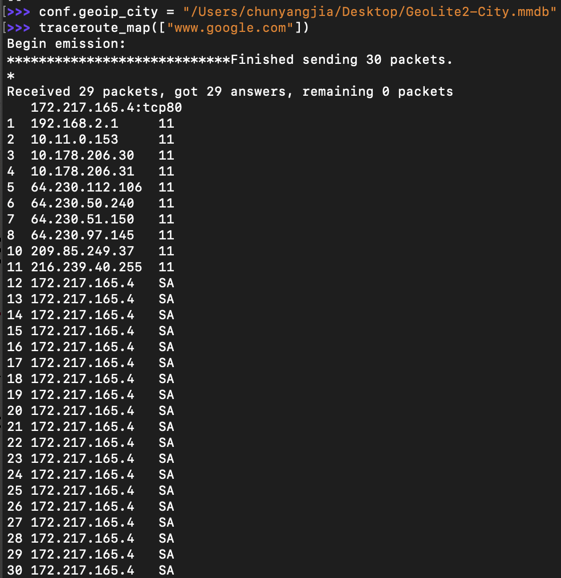
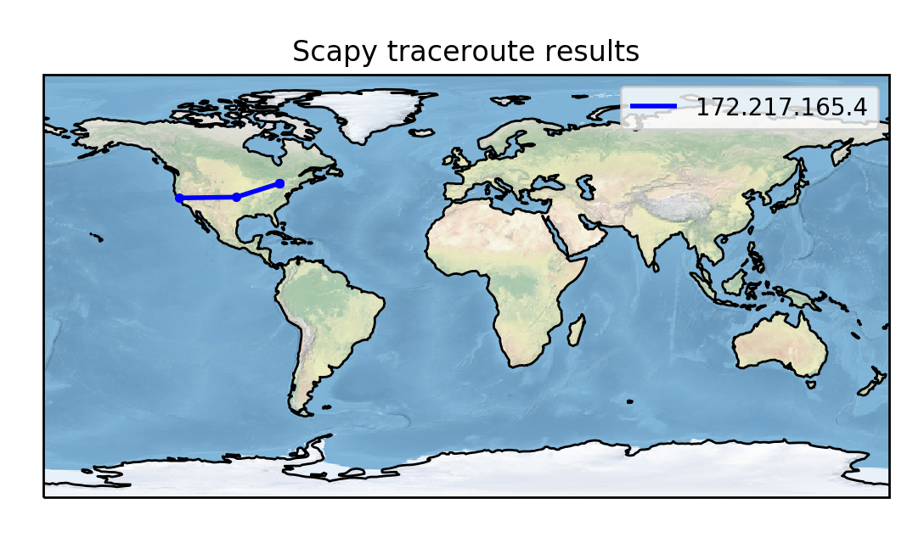
Trace route
In computing, traceroute is to display the route(path) and measuring transit delays of packets across an Internet Protocol network.

Slide 14
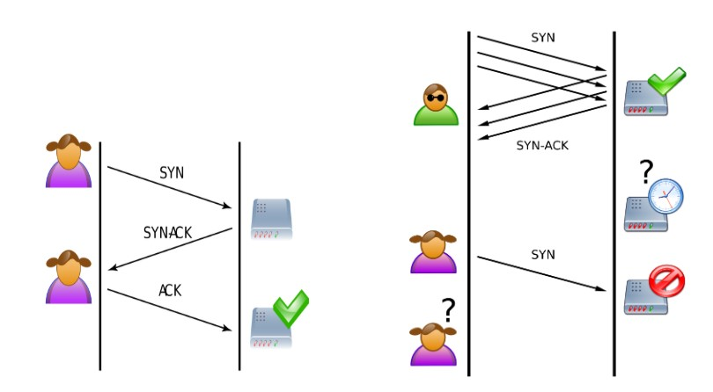
SYN flood attacks
One type of DoS (Denial of Service) attacks
Takes advantage of the TCP protocol’s “three-way handshake”
Notes:
Tcp ,server buffer is full with half-open TCP connections, it stops accepting SYN connections, thus resulting in denial of service to legitimate clients.
1. SYN Flooding is a form of DoS attack where an attack sends a succession of SYN requests to a target’s system in an attempt to consume enough server resources to make the system unresponsive to legitimate traffic.
2. A client sends a TCP SYN (S flag) packet to begin a connection to the server. The target server replies with a TCP SYN-ACK (SA flag) packet, but the client does not respond to the SYN-ACK, leaving the TCP connection “half-open”. In normal operation, the client should send an ACK (a flag) packet followed by the data to be transferred, or an RST reply to reset the connection. On the target server, the connection is kept open, When the server’s SYN buffer is full with half-open TCP connections, it stops accepting SYN connections, thus resulting in denial of service to legitimate clients.

Slide 15
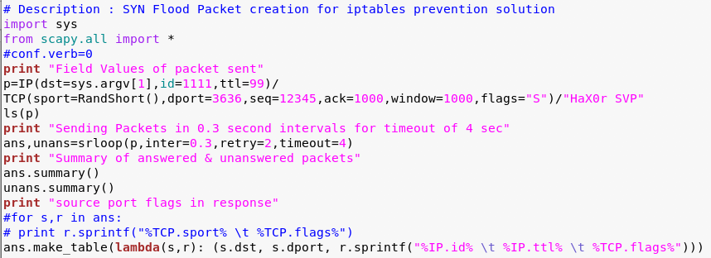
basic concept of the SYN Flood attack
Notes:
3.As you can see, this script will take the destination IP as input, and will create connections from different ports. Random custom field values are used for TTL (Time to live) and ID, to obfuscate the identity in case any IDS/IPS (Intrusion Detection System/Intrusion Prevention System) is present at the target side
4.The randshort() function is used to generate random port numbers for the sport (source port) of the TCP packet. The destination port (dport) is set to port 22 (SSH) and 80 (Apache Web server). The TCP connect flag is set to SYN using the flags option
5.The srloop function sends p crafted packets at intervals of 0.3 seconds. The results of srloop are collected in ans (for answered packets) and unans (for unanswered packets). The gathered results are displayed in a table format for the reply flags and TTL values.
6.The target’s reply of SA shows that it “thinks” the ACK from attacker/initiator was lost; hence, it keeps re-sending it, for an interval specified by the kernel.
7. Now once the program will start executing, it will send SYN packets to destination port 5000 from random source port numbers. For few packets the server will reserve space in the buffer and reply with a SYN+ACK, waiting for ACK from client which will never be sent. Once the server TCP buffer gets exhausted, it will send RA (Reset + ACK) packets. This packet means that the SYN is received and acknowledged by the server but a connection to the server is refused.

Slide 16
Show time
TRACEROUTE
SYN FLOOD ATTACK

Slide 17
Conclusion
.
SCAPY is a very powerful tool, but you must know what you are doing.
Notes:
Limitations:
Can’t handle too many packets. Won’t replace a mass-scanner.
Usually don’t interpret for you. You must know what you’re doing.
Stimulus/response(s) model. Won’t replace netcat,socat, . . . easily
Pros:
Scapy has its own ARP stack and its own routing table.
Scapy works the same for layer 2 and layer 3
Scapy bypasses local firewalls
Fast packet designing
Default values that work
Unlimited combinations
Probe once, interpret many
nteractive packet and result manipulation

Slide 18
Thank you

